Slide 1



A Portfolio of Advantaged
Sustainability Solutions
What is Partners for Tomorrow?
Mutually beneficial for our customers and PepsiCo
Driving progress toward sustainability goals and commercial value
1

Slide 2


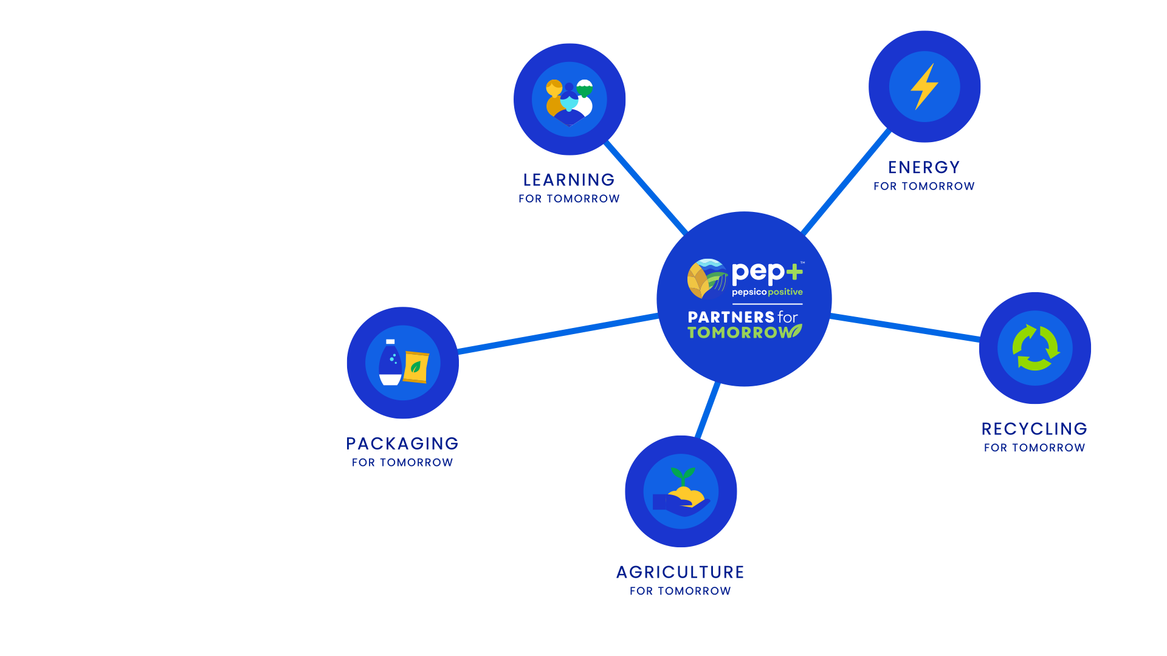
AGRICULTURE
FOR TOMORROW
RECYCLING
FOR TOMORROW
Sow Positive (Sow+)
CIRQU
Oscar Sort
Recycling Bins
Recycle Rally
Olyns Reverse Vending
LEARNING
FOR TOMORROW
PACKAGING
FOR TOMORROW
Sustainability Summit
Sustainability
Action Center
Sustainable Cups
ENERGY
FOR TOMORROW
pep+ REnew
Solutions that span key sustainability categories
2
Notes:
Partners for Tomorrow – a suite of sustainability solutions available to value chain partners, notably our customers. The program was named the “sustainability initiative of the year” by Business Intelligence Group.
We have launched programs with partners in agriculture, we have a number of sources available for our customers and partners to leverage – e.g. the sustainability summit and the sustainability action center and we launched pep+ renew which helps our partners to convert to renewable energy. The two categories of solutions we’re going to focus on today are packaging and recycling.
www.partnersfortomorrow.com

Slide 3


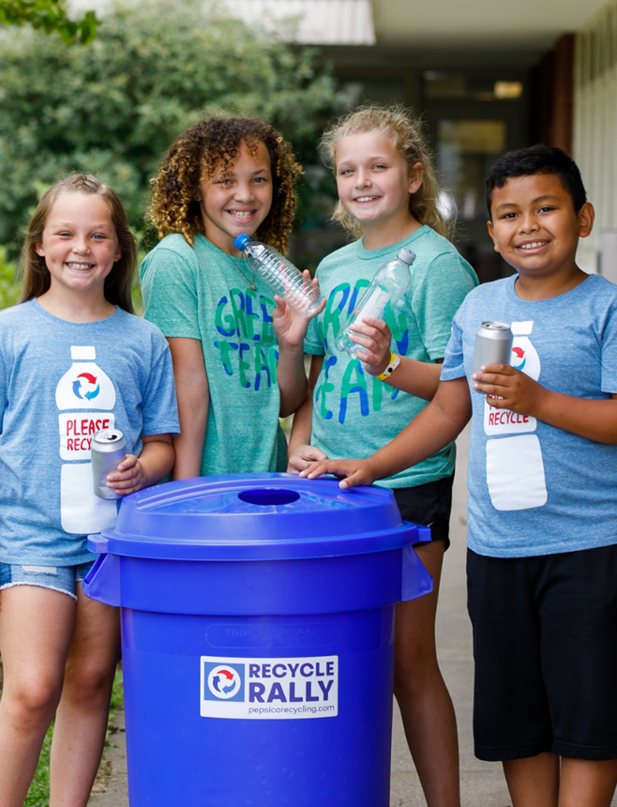
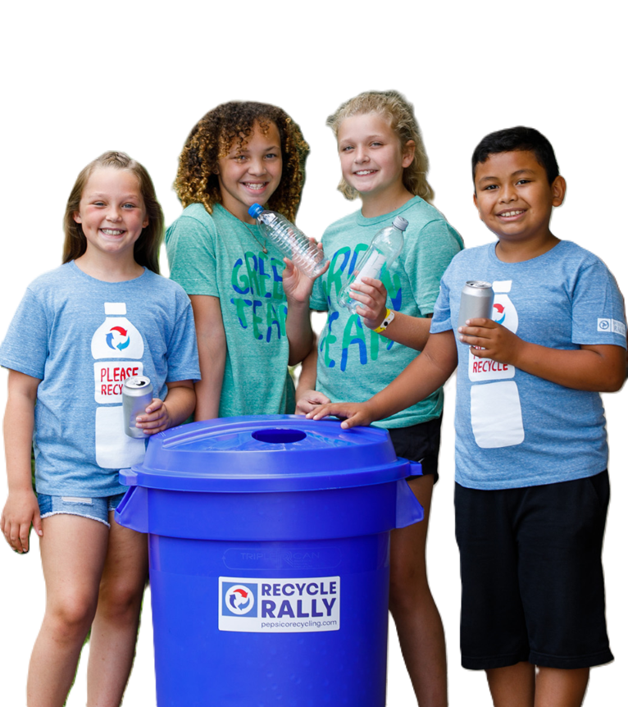






ENGAGING YOUTH THROUGH
RECYCLING EDUCATION
POSITIVE
VALUE CHAIN
Today’s students are tomorrow’s leaders
Recycle Rally is a PepsiCo funded recycling program for
K-12 schools throughout the U.S. The model is designed to help students become lifelong recyclers by equipping, educating, and inspiring them to get directly involved with recycling
4.5M+
Students
Engaged
650M
Beverage
Containers Recycled
7,000+
Schools Impacted
$4M+
Awarded
3
Notes:
How makes a difference/or is a solution in pep+ agenda

Slide 4





HOW IT WORKS
Resources
Report/Track
See Impact
Earn Rewards
Resources to
Teach & Learn
Reporting
System to Engage
Relatable
Impact to WOW
Prizes & Rewards
to Incentivize
Participating schools have access to hundreds of free resources to teach students about the importance of recycling
Schools regularly report recycling totals by weight or by # of bins (of selected materials)
As schools recycle, they can visualize their impact in new, interesting ways:
As schools recycle, they earn reward points for which they can redeem for supplies or incentives
Tracks school’s impact
Teaches students essential skills such as accountability and responsibility
Weight of wild animals
Landfill space saved
Energy saved
Trees saved
GHG emissions avoided
Recycling bins and supplies
(dollies, bags, etc.)
Gift cards (to reward students
and staff)
Sustainable gear such as tee shirts and reusable straws
Games
Lesson Plans
Videos
Slideshows
…and much more!
4
Notes:
Program overview and how to implement

Slide 5
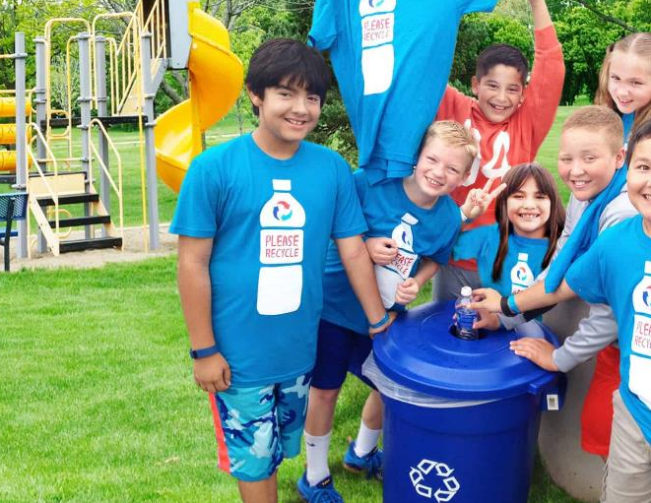




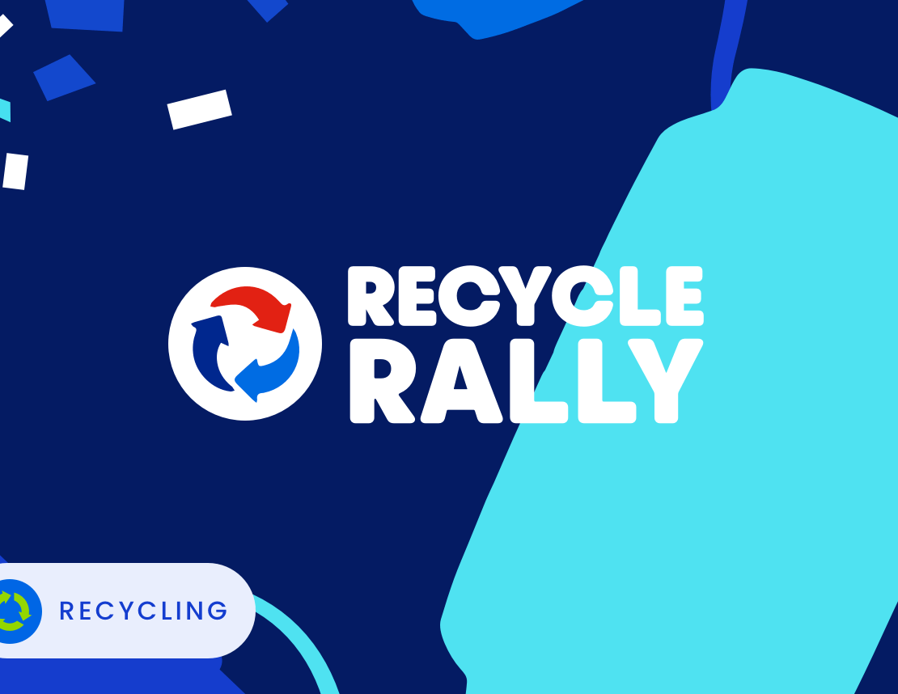
FEATURES & BENEFITS
Teaching the Leaders of Tomorrow the Importance of Recycling
FUNDED BY PEPSICO
Hundreds of educational resources and tools to guide activities and learning plans
ENGAGEMENT
Opportunities for customers to engage with school faculty, students, families, and broader community in your efforts
Customers can show they care about making their communities more sustainable by helping to fund incentives, recycling bins
and supplies.
Customer can strengthen relationships with schools by co-branding a contest or support with judging criteria and process.
Customer can add to their store’s foot traffic by collaborating with local schools to share or fund recycling infrastructure, which in some cases may enable schools to participate when they
couldn’t before.
5
Notes:
Feature/benefits of participating as a partner

Slide 6


COMMERCIAL SUSTAINABILITY CONTACTS
LET’S PARTNER!
Shanna Parra
Director Commercial Sustainability
Email: shanna.parra@pepsico.com
Catherine Walton
Senior Manager Commercial Sustainability
Email: catherine.walton@pepsico.com
6
Notes:
Add Pree?

