Slide 1


Let’s partner today for a more sustainable tomorrow.
Introducing:

Slide 2

What is Partners for Tomorrow?

Slide 3
Partners for Tomorrow:
A robust portfolio of sustainability solutions for our partners designed to help meet shared sustainability goals.
AGRICULTURE
FOR TOMORROW
RECYCLING
FOR TOMORROW
LEARNING
FOR TOMORROW
PACKAGING
FOR TOMORROW
ENERGY
FOR TOMORROW

Slide 4
Partners for Tomorrow:
A robust portfolio of sustainability solutions for our partners designed to help meet shared sustainability goals.
AGRICULTURE
FOR TOMORROW
RECYCLING
FOR TOMORROW
sow+ Agriculture
CIRQU
LEARNING
FOR TOMORROW
PACKAGING
FOR TOMORROW
Recycling Bins
Recycle Rally
Sustainability Summit
SodaStream Professional
Sustainability Action Center
ENERGY
FOR TOMORROW
Sustainable Cups
pep+ REnew

Slide 5
Partners for Tomorrow:
A robust portfolio of sustainability solutions for our partners designed to help meet shared sustainability goals.
AGRICULTURE
FOR TOMORROW
RECYCLING
FOR TOMORROW
LEARNING
FOR TOMORROW
PACKAGING
FOR TOMORROW
ENERGY
FOR TOMORROW

Slide 6


SUSTAINABILITY SUMMIT
Be inspired by industry leaders.
The Sustainability Summit us a forum where all of PepsiCo’s partners from
across our entire value chain can come together to get the latest intel on the most important sustainability issues facing the food and beverage industry today, and what businesses can do to thrive.
Let’s listen and learn together.
Notes:
Link to overview video: PepsiCo Sustainability Summit on Vimeo

Slide 7
SUSTAINABILITY SUMMIT
A few example topics
Global and local sustainability trends
Sustainability and the consumer: understanding consumer behaviors
and priorities
Deep dives into the most important topics of the day, from packaging to climate to the economic landscape
“I enjoyed the real world examples of product changes and the inclusiveness of showing how communities are impacted as well as how people can get involved at a community level.”
“Enjoyed listening to all the speakers… there definitely needs to be more discussion across everyone in total in regards to sustainability.”
“This was a great high-level presentation! Love all of the initiatives PepsiCo has put in place and continues to improve on. Thank you all for taking the time to present!”
REGISTRATION COMING SOON
Notes:
Partners for Tomorrow website (available early April) will host the registration for our distribution list

Slide 8

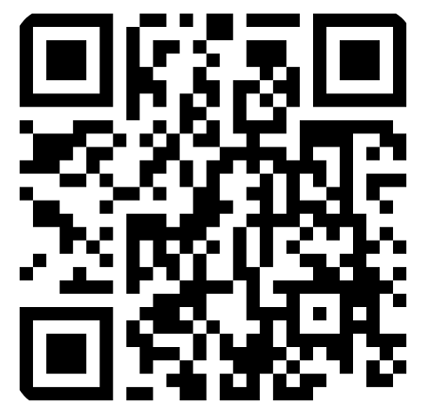

SUSTAINABILITY ACTION CENTER
We’re providing resources to help our partners reduce greenhouse gas emissions.
Through the Sustainability Action Center, you can take a quick assessment to determine your business’s climate maturity level and find relevant resources to help guide you on your journey to reducing greenhouse gas (GHG) emissions.
Get started here.

