Slide 1


Let’s partner today for a more sustainable tomorrow.
Introducing:

Slide 2

What is Partners for Tomorrow?

Slide 3
Partners for Tomorrow:
A robust portfolio of sustainability solutions for our partners designed to help meet shared sustainability goals.
AGRICULTURE
FOR TOMORROW
RECYCLING
FOR TOMORROW
LEARNING
FOR TOMORROW
PACKAGING
FOR TOMORROW
ENERGY
FOR TOMORROW

Slide 4
Partners for Tomorrow:
A robust portfolio of sustainability solutions for our partners designed to help meet shared sustainability goals.
AGRICULTURE
FOR TOMORROW
RECYCLING
FOR TOMORROW
sow+ Agriculture
CIRQU
LEARNING
FOR TOMORROW
PACKAGING
FOR TOMORROW
Oscar Sort
Cups for Tomorrow
Recycling Bins
Sustainability Summit
Recycle Rally
Sustainability Action Center
ENERGY
FOR TOMORROW
pep+ REnew

Slide 5
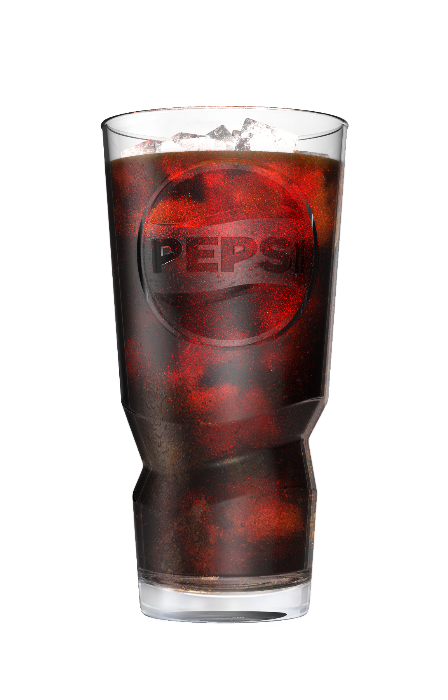


CUPS FOR TOMORROW
Benefits of Switching to Reusable Cups
Cups for Tomorrow is a set of resources that equip our partners with the tools they need to transition from disposable cups to reusable cups for on-site dining seamlessly.
Enhance Experience
Improve customer experience with high quality drinkware.
Save Money
Save money by ditching disposable cups.
Be a Leader
Demonstrate your commitment as a sustainability leader.

Slide 6
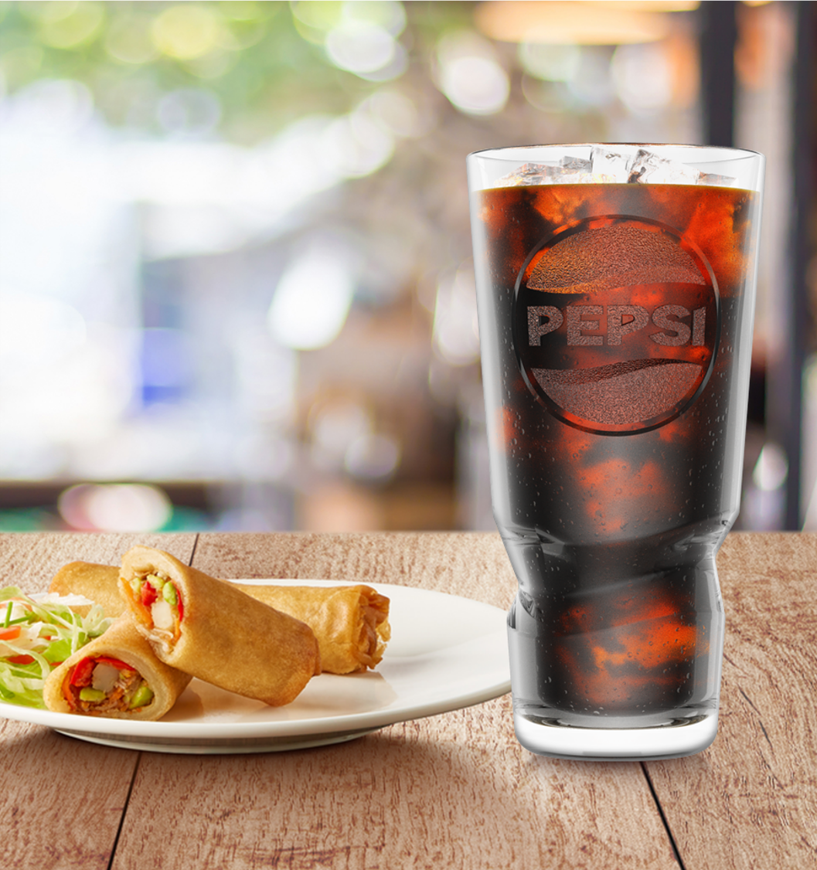




CUPS FOR TOMORROW
Easily Transition Your Business
Cups for Tomorrow offers practical solutions to help businesses transition from disposable to reusable cups and dishware. With our resources, you can make the switch and get back to what matters most – serving your customers and growing your business. Cups for Tomorrow offers:
Reusable Pepsi tumblers
Interactive savings calculator
Training materials
Signage
LEARN MORE AT CUPSFORTOMORROW.COM

Slide 7
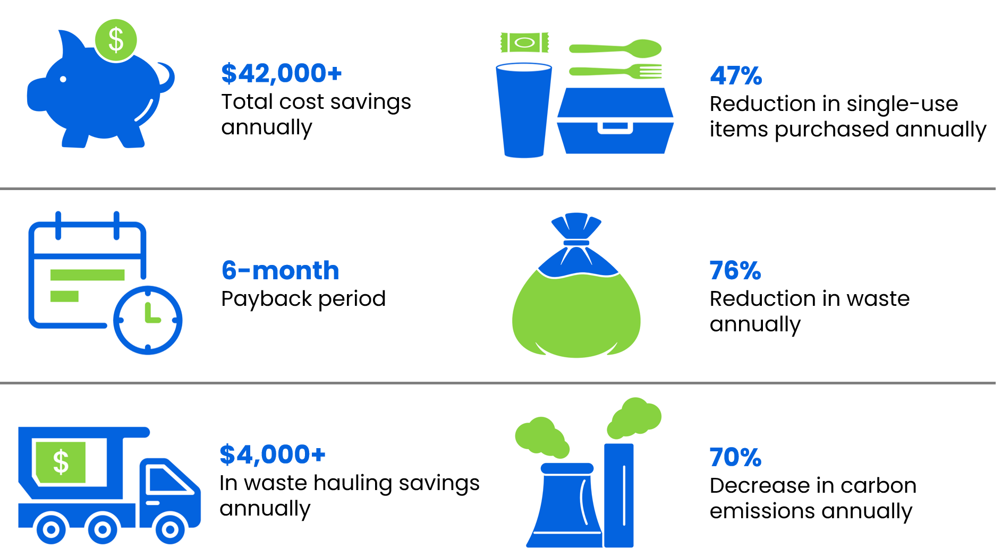

CUPS FOR TOMORROW
Switch to reusable dishware.
Reduce your impact and save money!
*Estimates calculated using Chart Reuse date for restaurants with 400 daily customers.
Get an estimate for your savings and find resources
to help you make the switch today at
cupsfortomorrow.com

